Slide 1


Could you open the eyes of a young person to an exciting career that they didn’t even know existed?
Your story, ideas, and real-world advice can help shape a young person’s career choices. The Give an Hour programme invites you to give an hour of your time to create new perspectives and inspire new ideas.
To find out more, visit careersandenterprise.co.uk/give-an-hour

Slide 2













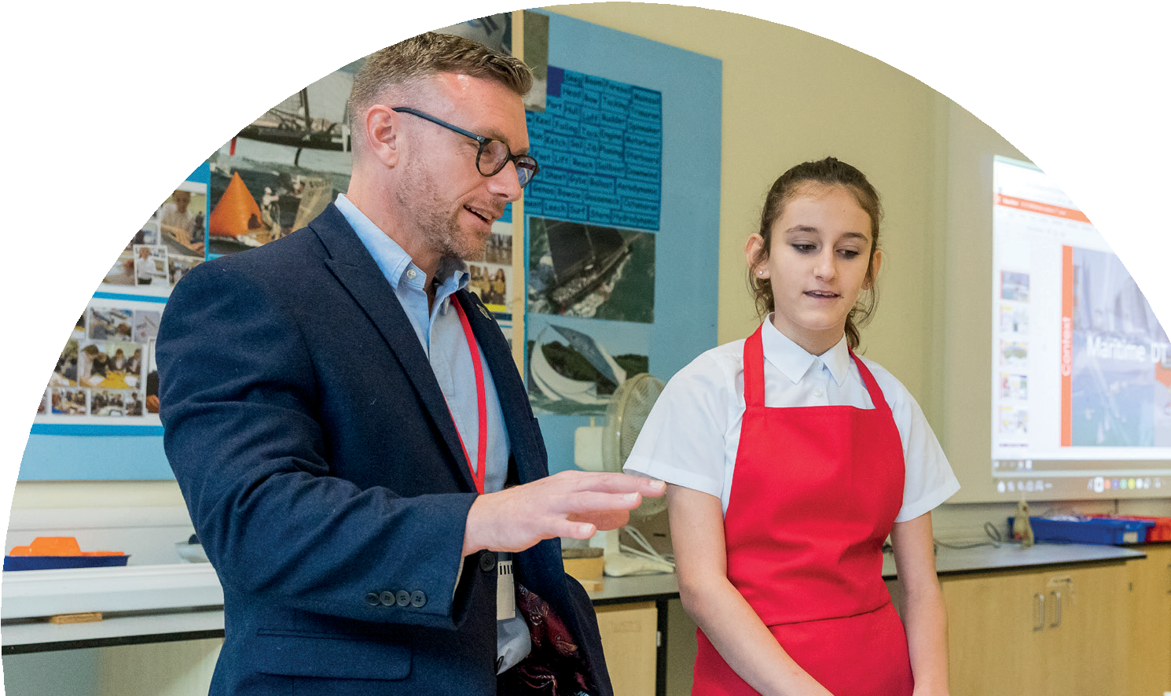
Ways to get involved
There are many ways to get involved - here are just some of the ways you can help to inspire a young person in an hour.
Share your career journey in an assembly or classroom to help students understand the world of work.
Bring a subject to life by sharing an experience from your industry or workplace.
Use your experience to take part in mock interviews or CV writing workshops.
Speed networking, answer young people’s questions about your career in a quick fire setting.
Share your entrepreneurial skills and experience through an engaging enterprise activity.
Register today at careersandenterprise.co.uk/give-an-hour to make a difference

