Slide 1



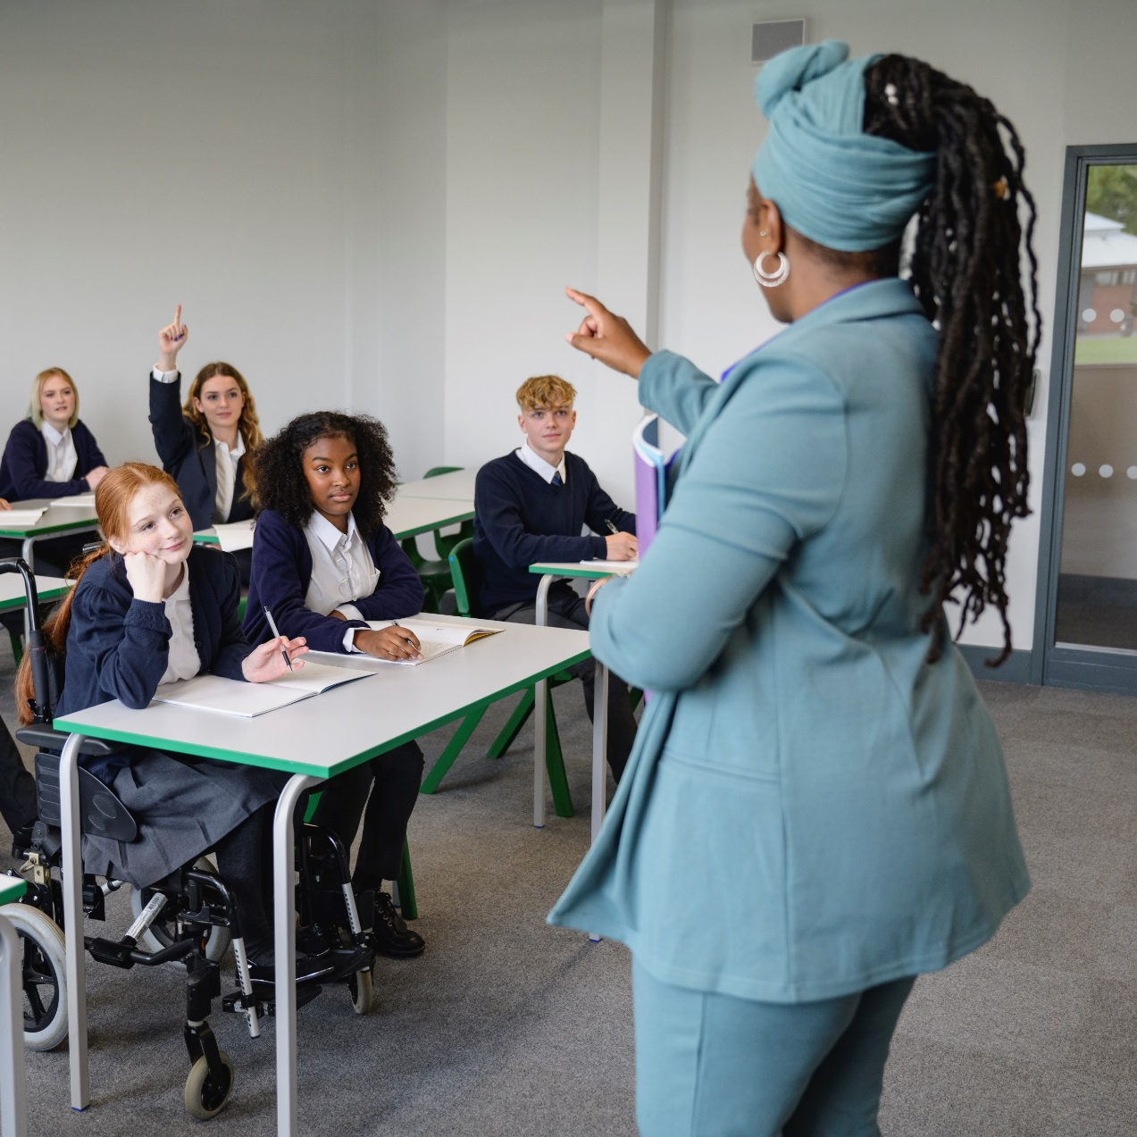

Helping to inspire and prepare young people for the world of work
Could you give an hour?
Register today

